Slide 1
Python Tutorial
S1 MCA

Slide 2
Python math Module
Python has a built-in module that you can use for mathematical tasks.
The math module has a set of methods and constants.
math.floor() | Rounds a number down to the nearest integer
math.ceil() | Rounds a number up to the nearest integer

Slide 3
Python Operators
Operators are used to perform operations on variables and values.
Python divides the operators in the following groups:
Arithmetic operators
Assignment operators
Comparison operators
Logical operators
Identity operators
Membership operators
Bitwise operators

Slide 4
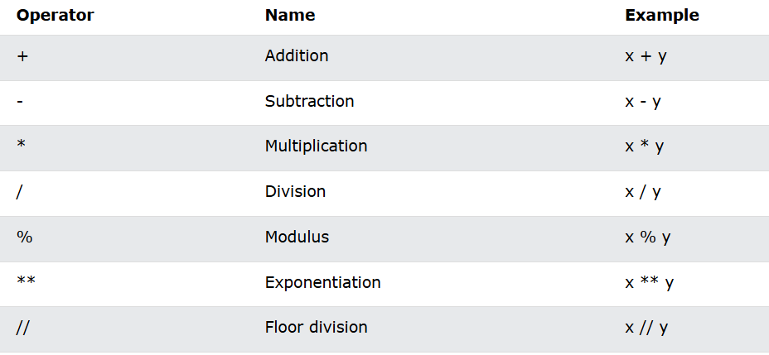
Python Arithmetic Operators
Arithmetic operators are used with numeric values to perform common mathematical operations:

Slide 5
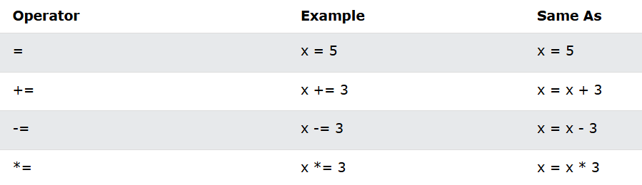
Python Assignment Operators
Assignment operators are used to assign values to variables:

Slide 6
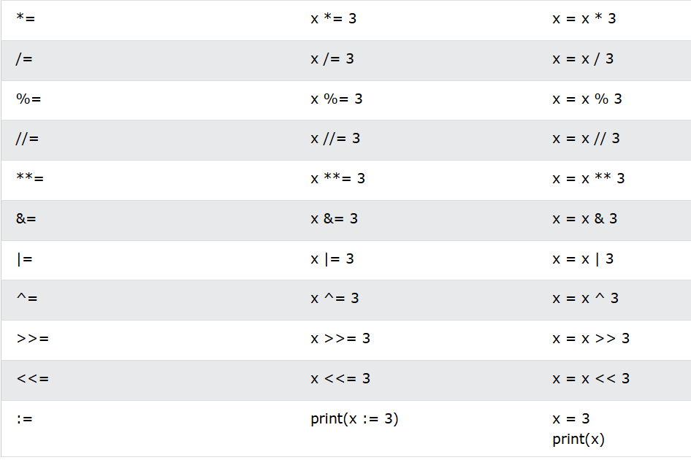

Slide 7
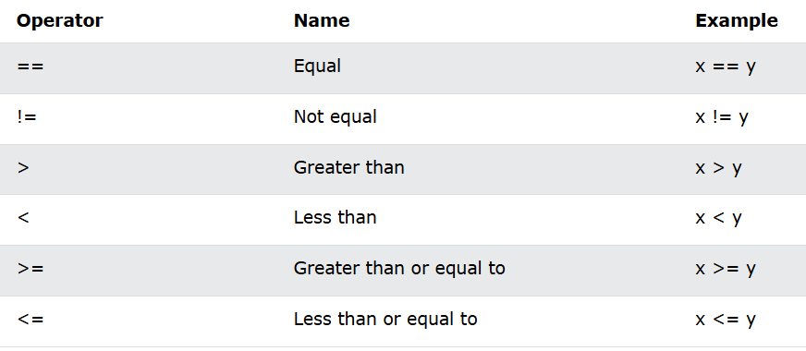
Python Comparison Operators
Comparison operators are used to compare two values:

Slide 8
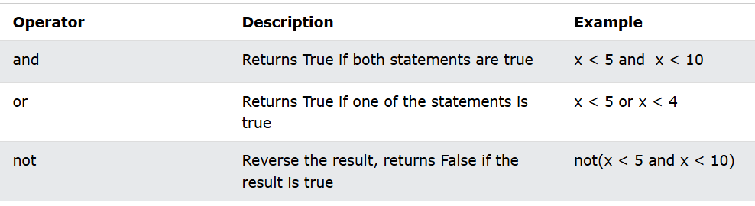
Python Logical Operators
Logical operators are used to combine conditional statements:

Slide 9
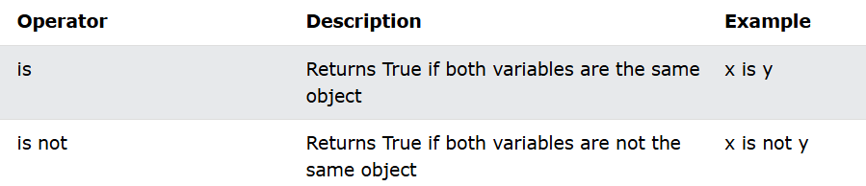
Python Identity Operators
Identity operators are used to compare the objects, not if they are equal, but if they are actually the same object, with the same memory location:

Slide 10
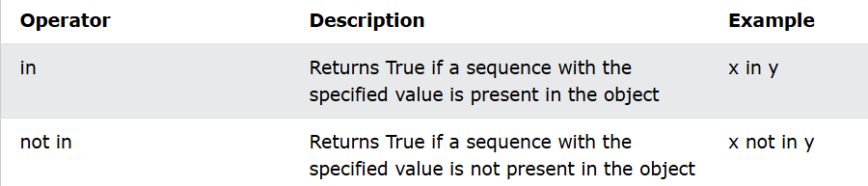
Python Membership Operators
Membership operators are used to test if a sequence is presented in an object:

Slide 11
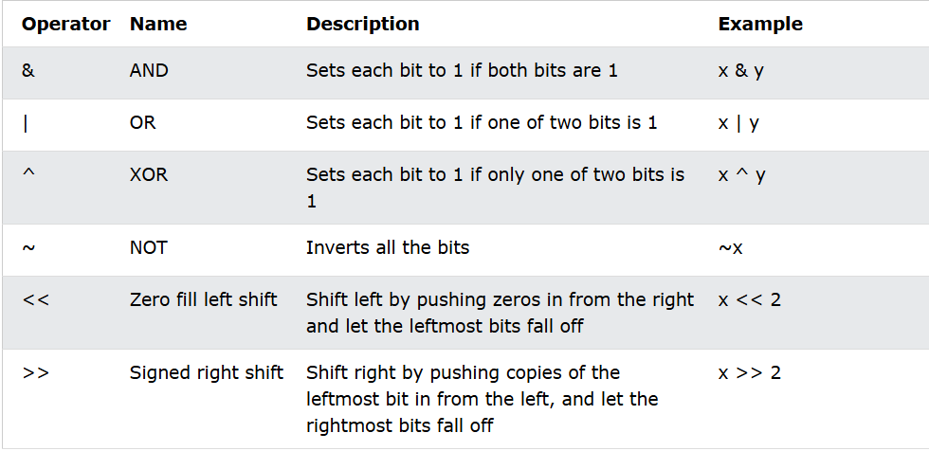
Python Bitwise Operators
Bitwise operators are used to compare (binary) numbers:

